Slide 1
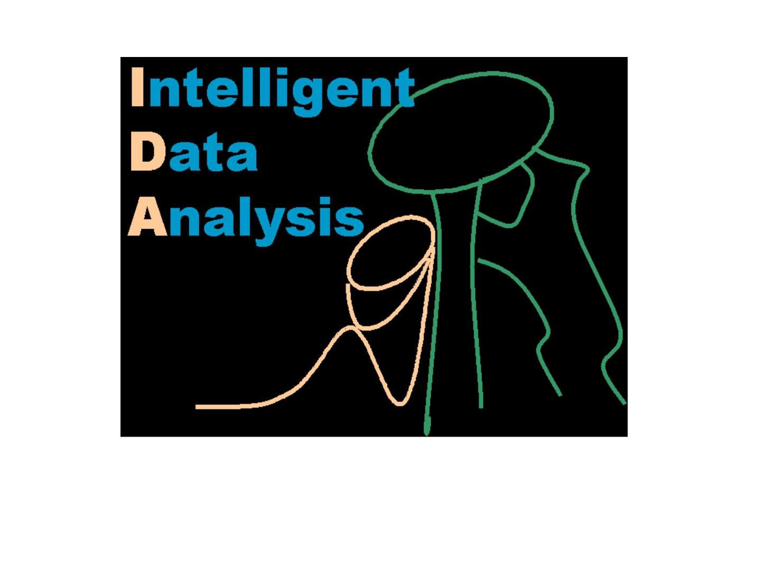

Slide 2
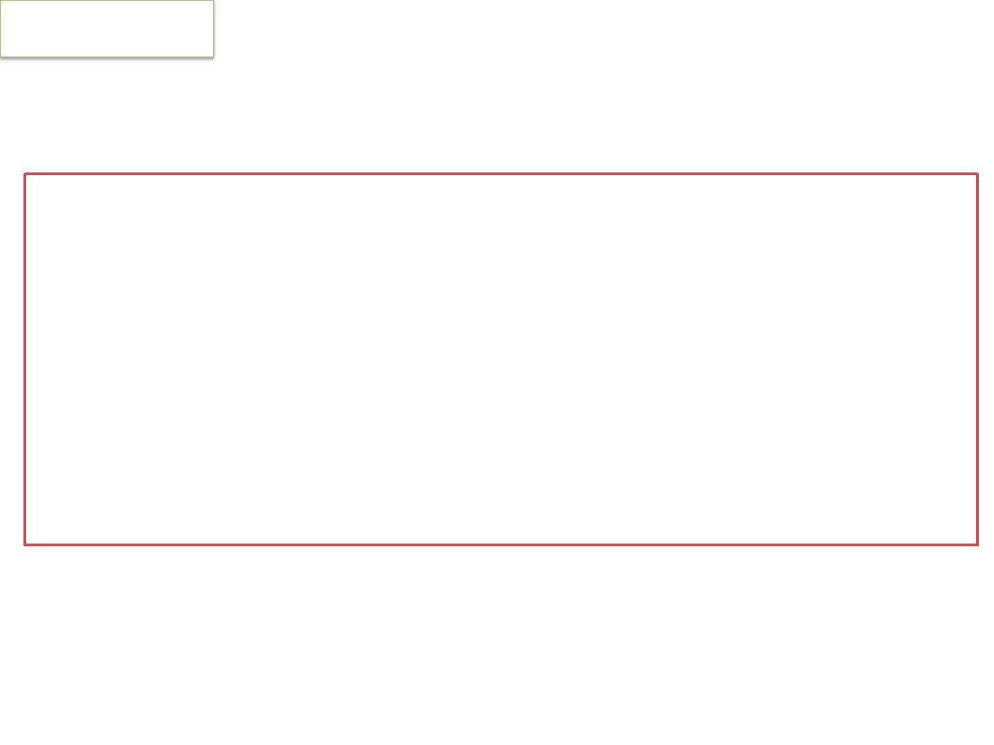
About IDA
IDA
an ‘interdisciplinary study of multiple MLA mainly
concerned and focused to effective analysis of big data’ and
relating the same with (interactive) visualization environment
mainly used for extracting useful information
•
•
•
from large quantities of online data;
extracting desirable knowledge
in finding out interesting patterns of existing databases

Slide 3
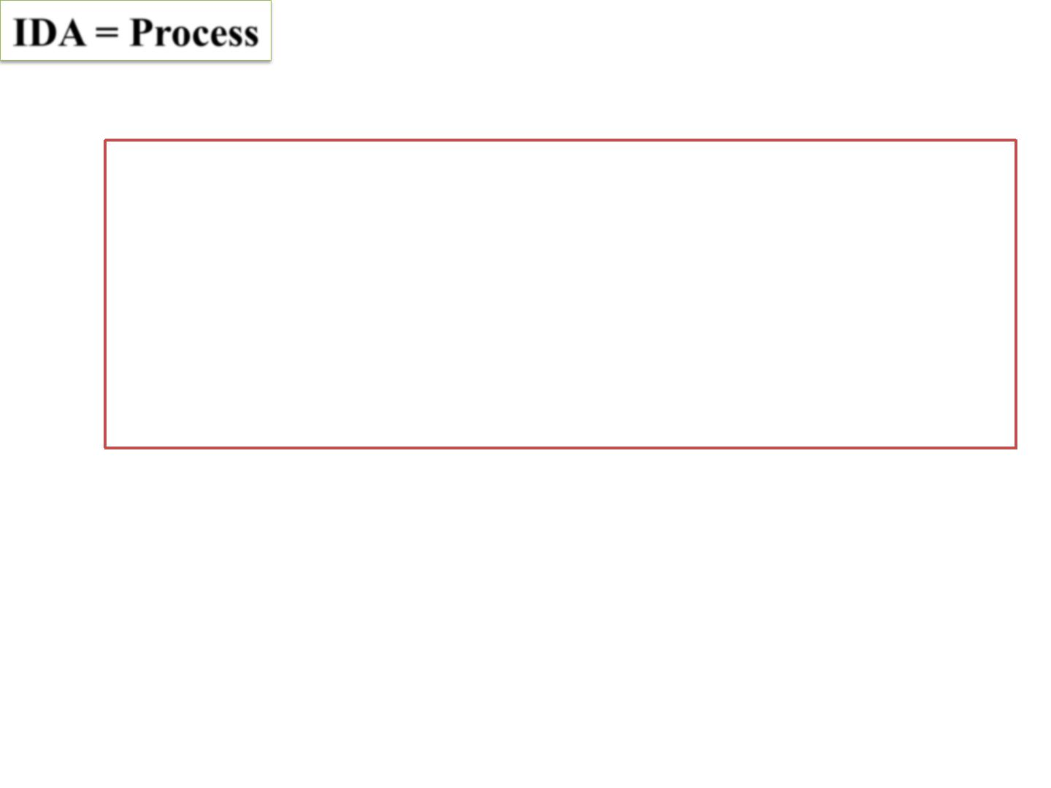
IDA Knowledge acquisition from data through
Knowledge discovery
Data mining
Genetic algorithm-based rule discovery
Multistage learning classifier system
Machine learning etc.

Slide 4
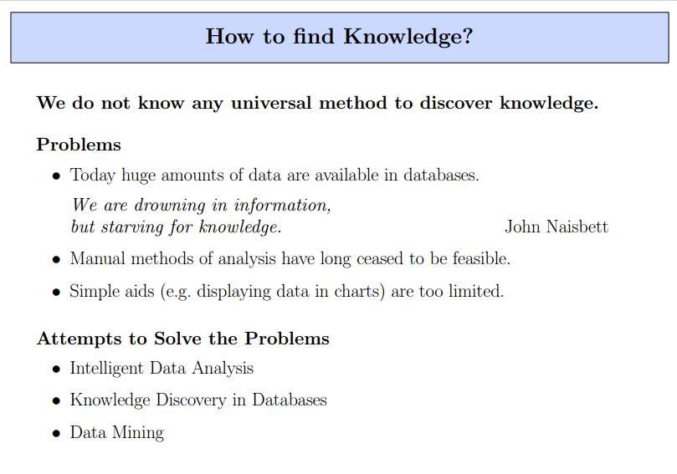

Slide 5
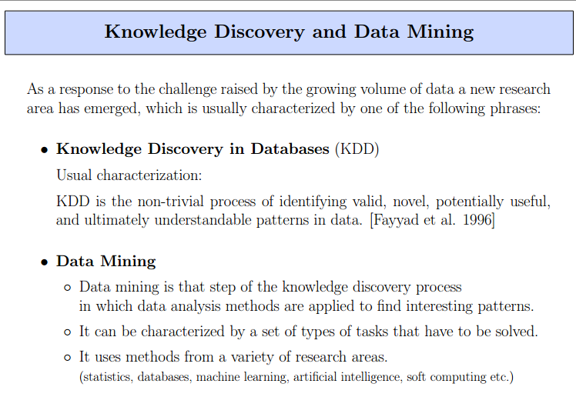

Slide 6
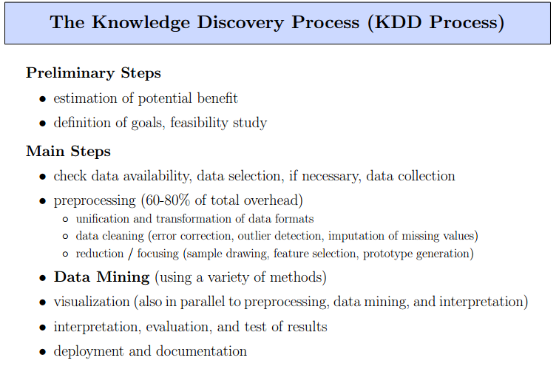

Slide 7
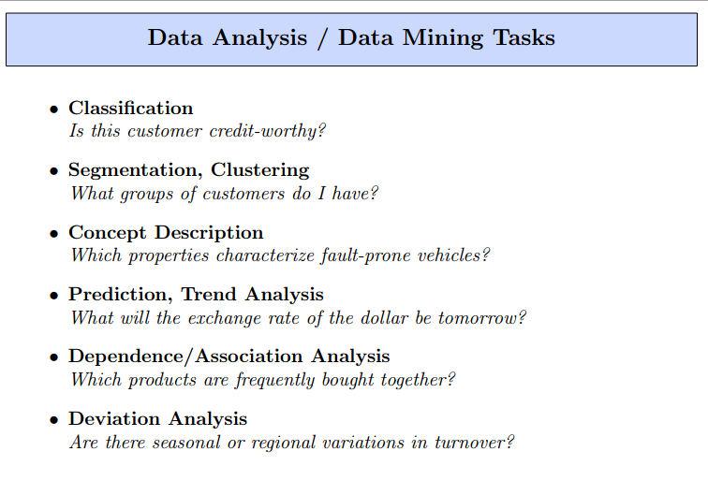
Notes:
Classification :This analysis is used to retrieve important and relevant information about data and metadata. This data mining method help to classify data in different classes
Clustering: This analysis is a data mining technique to identify data that are like each other. This process helps to understand the difference and similarities between the data
Associate Rules: This data mining technique helps to find the association between two or more items .it discovers a hidden pattern in the data set.

Slide 8
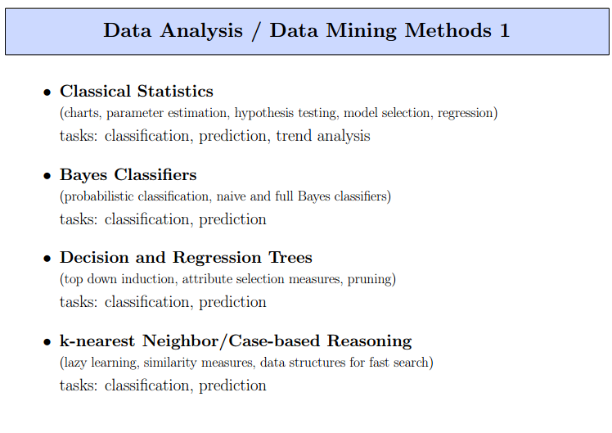
Notes:
Regression :this analysis is the data mining method of identifying and analysing the relationship between variables .It is used to identify the likelihood of a specific variable, given the presence of other variables.
Outer Detection: this type of data mining technique refers to observation of data items in the dataset which do not match an expected pattern or expected behavior.This technique can be used in a variety of domains ,such as intrusion ,detectio9 ,fraud or fault detection .Outer detection is also called as outlier analysis or outlier mining

Slide 9
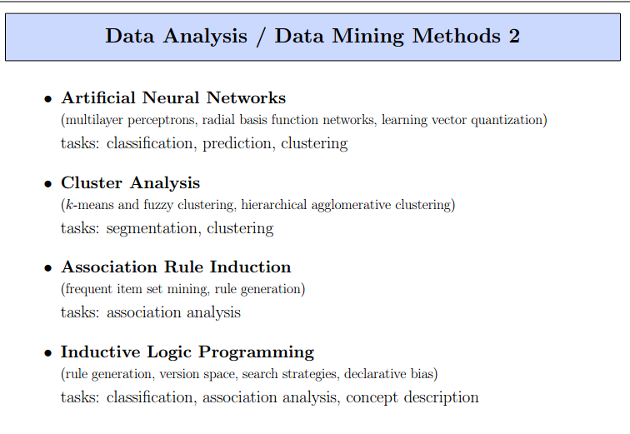

Slide 10
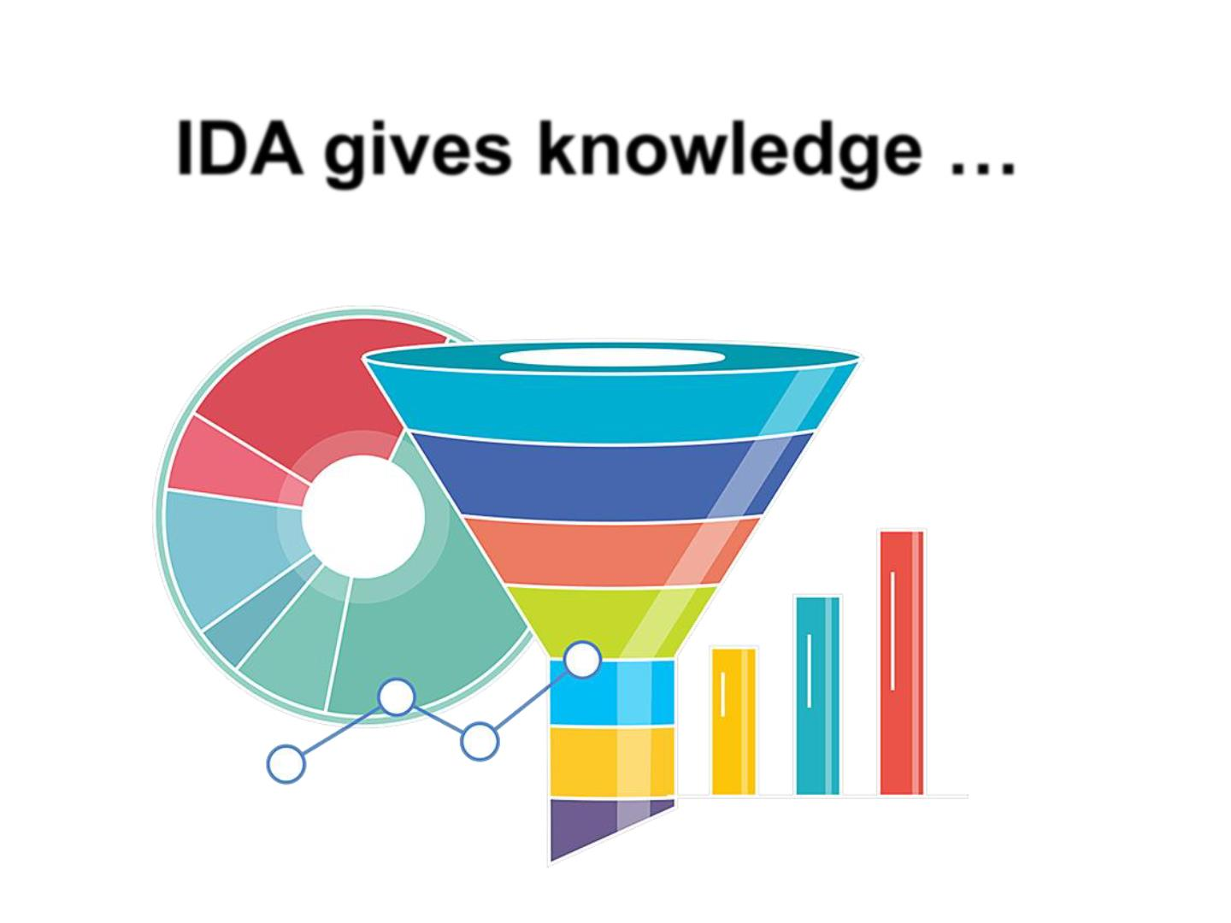

Slide 11
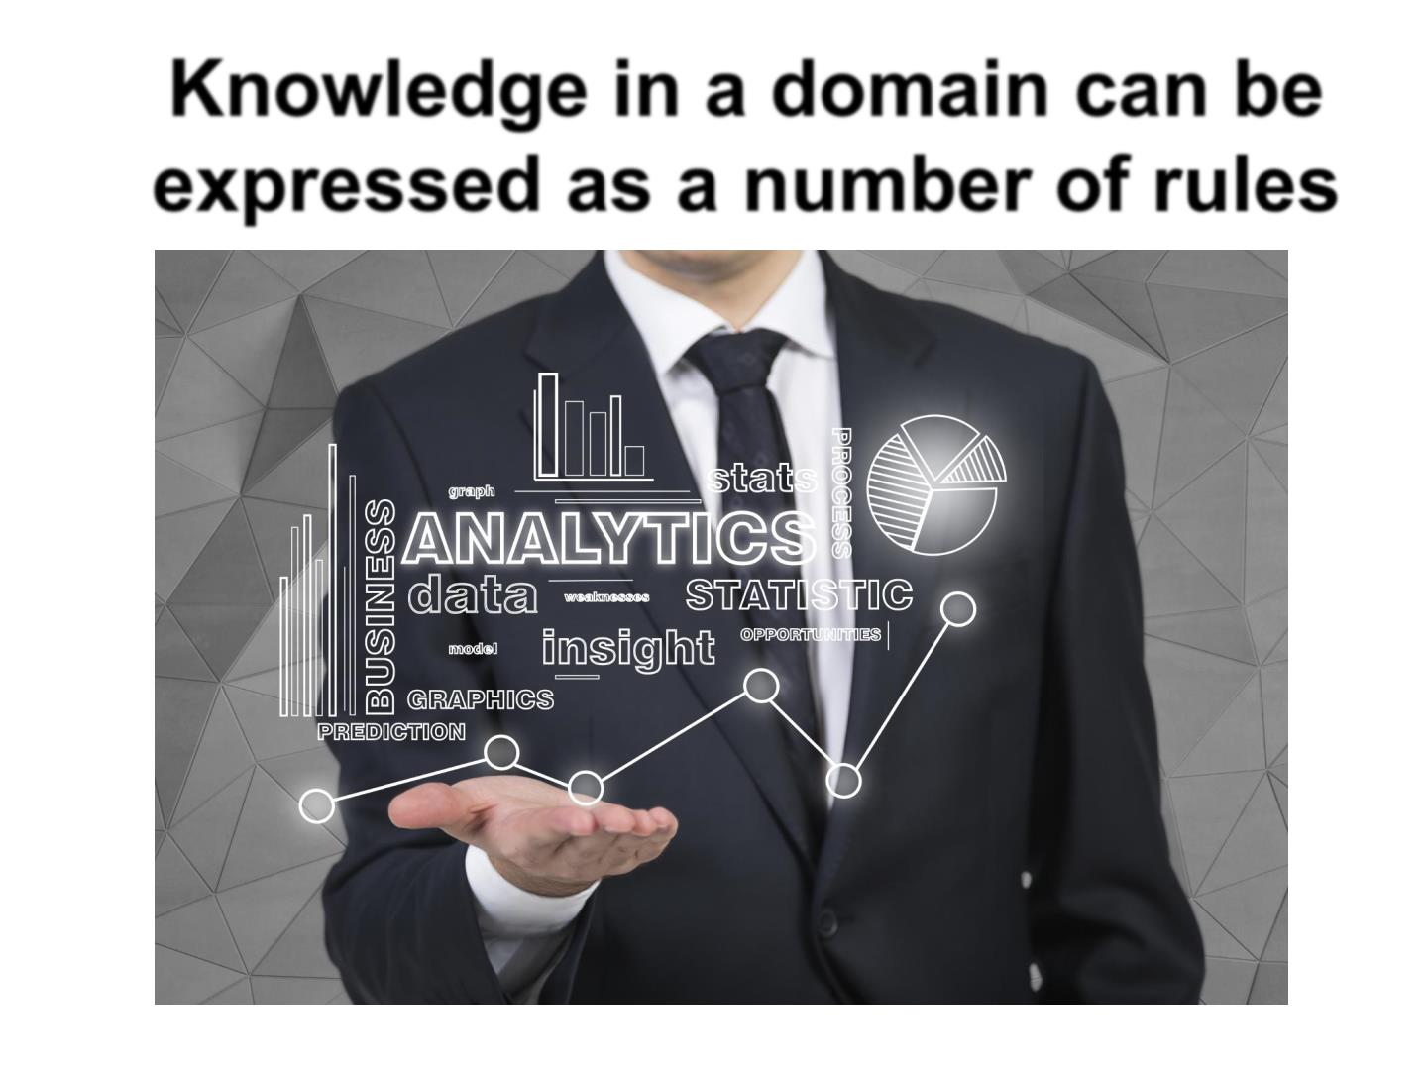

Slide 12
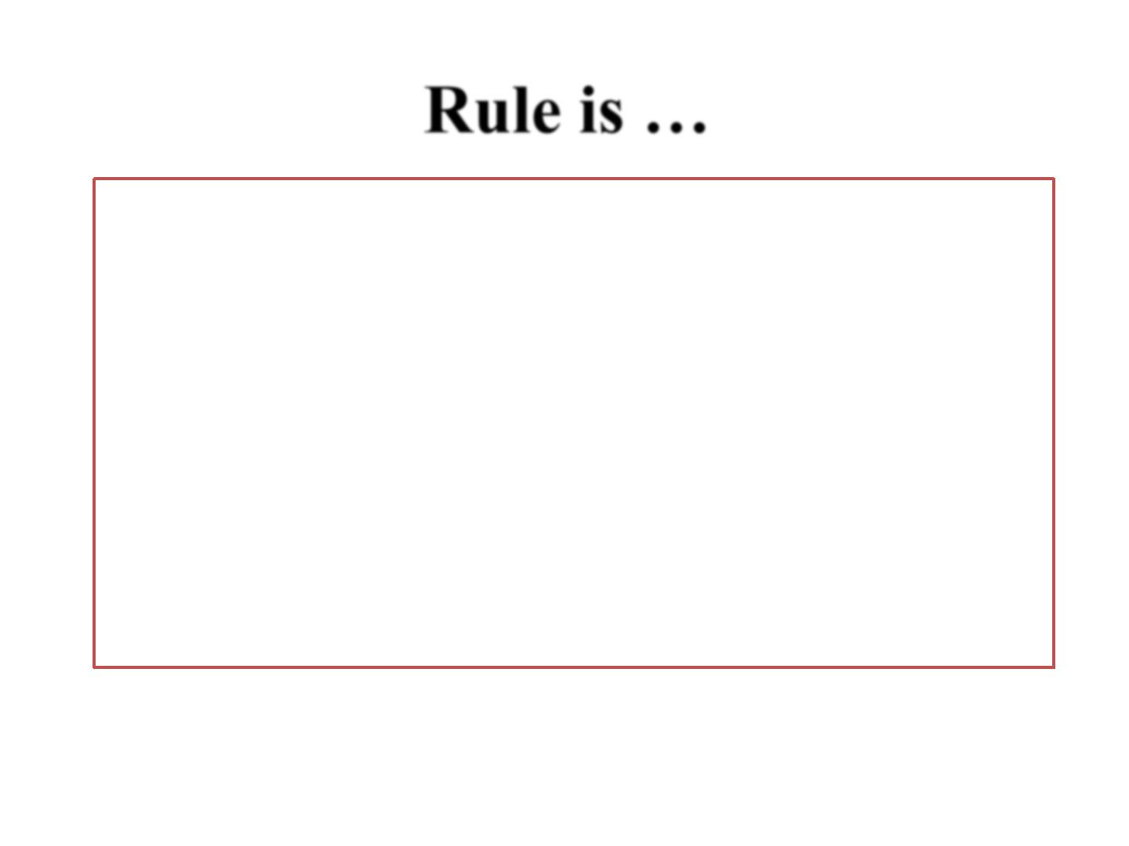
A formal way of specifying a
recommendation, directive, or strategy,
expressed as
"IF premise THEN conclusion"
or "IF condition THEN action“.

Slide 13
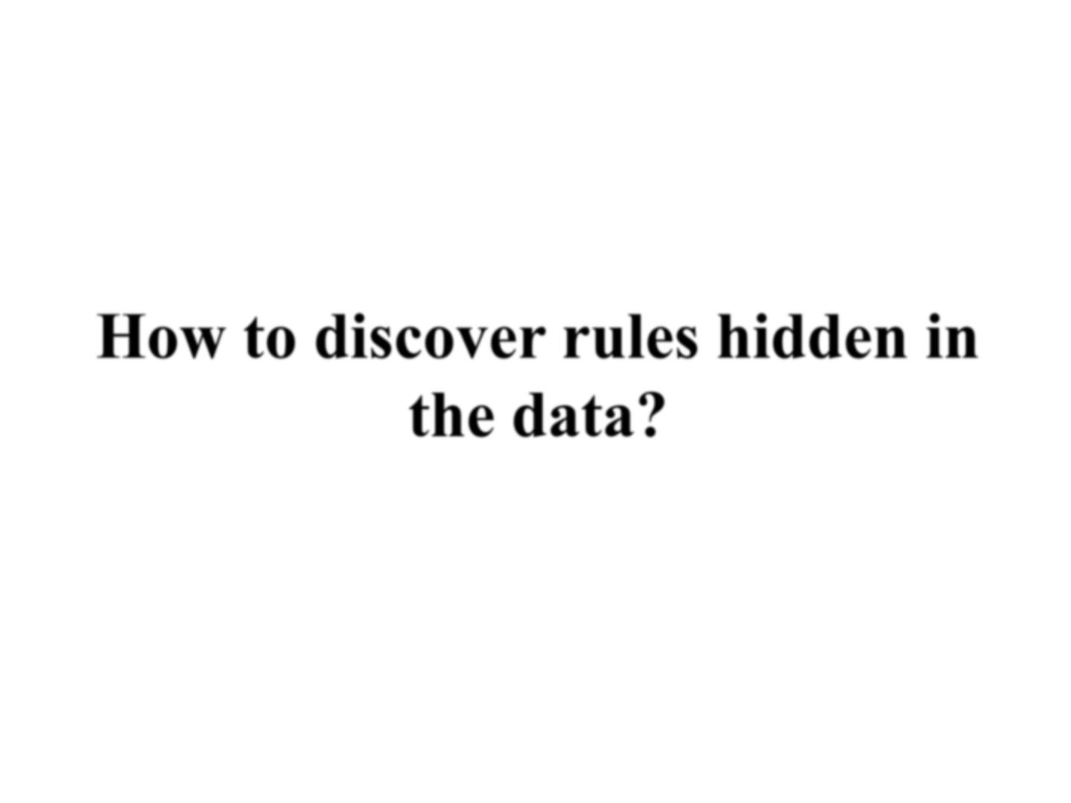

Slide 14
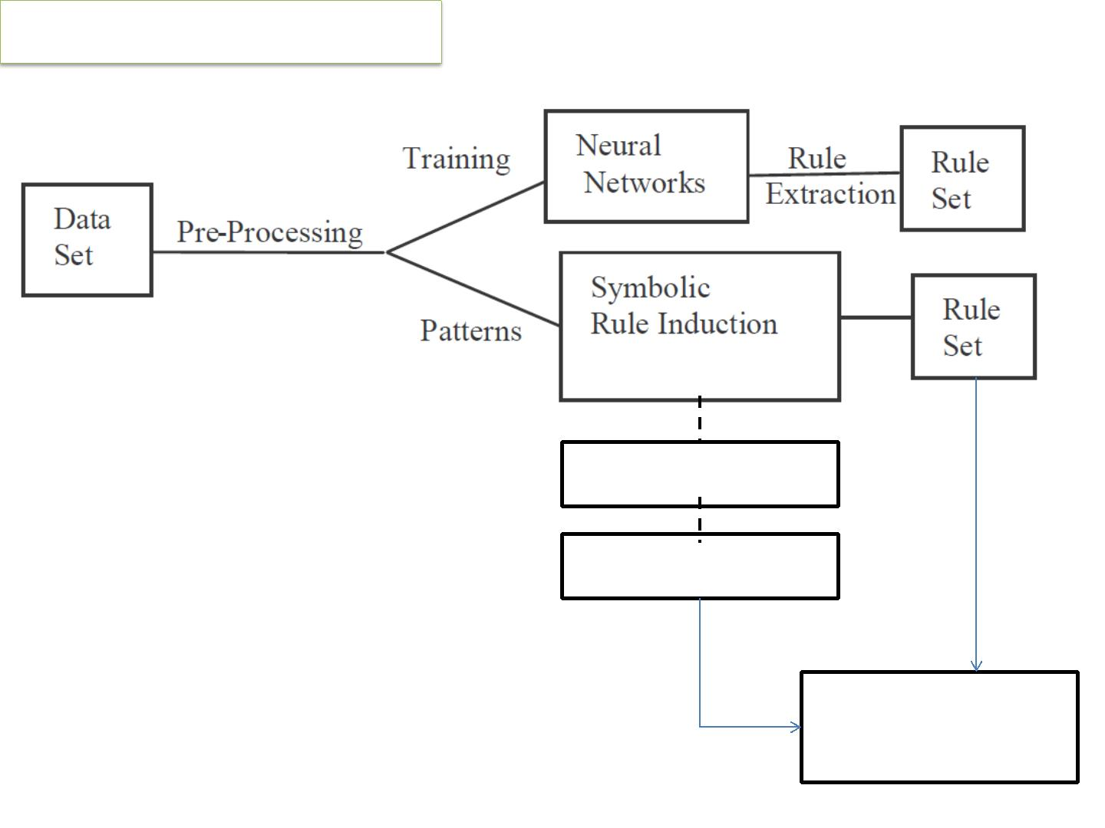
Through Analytic process
MLA..3
MLA..’n’
Desired Results

Slide 15
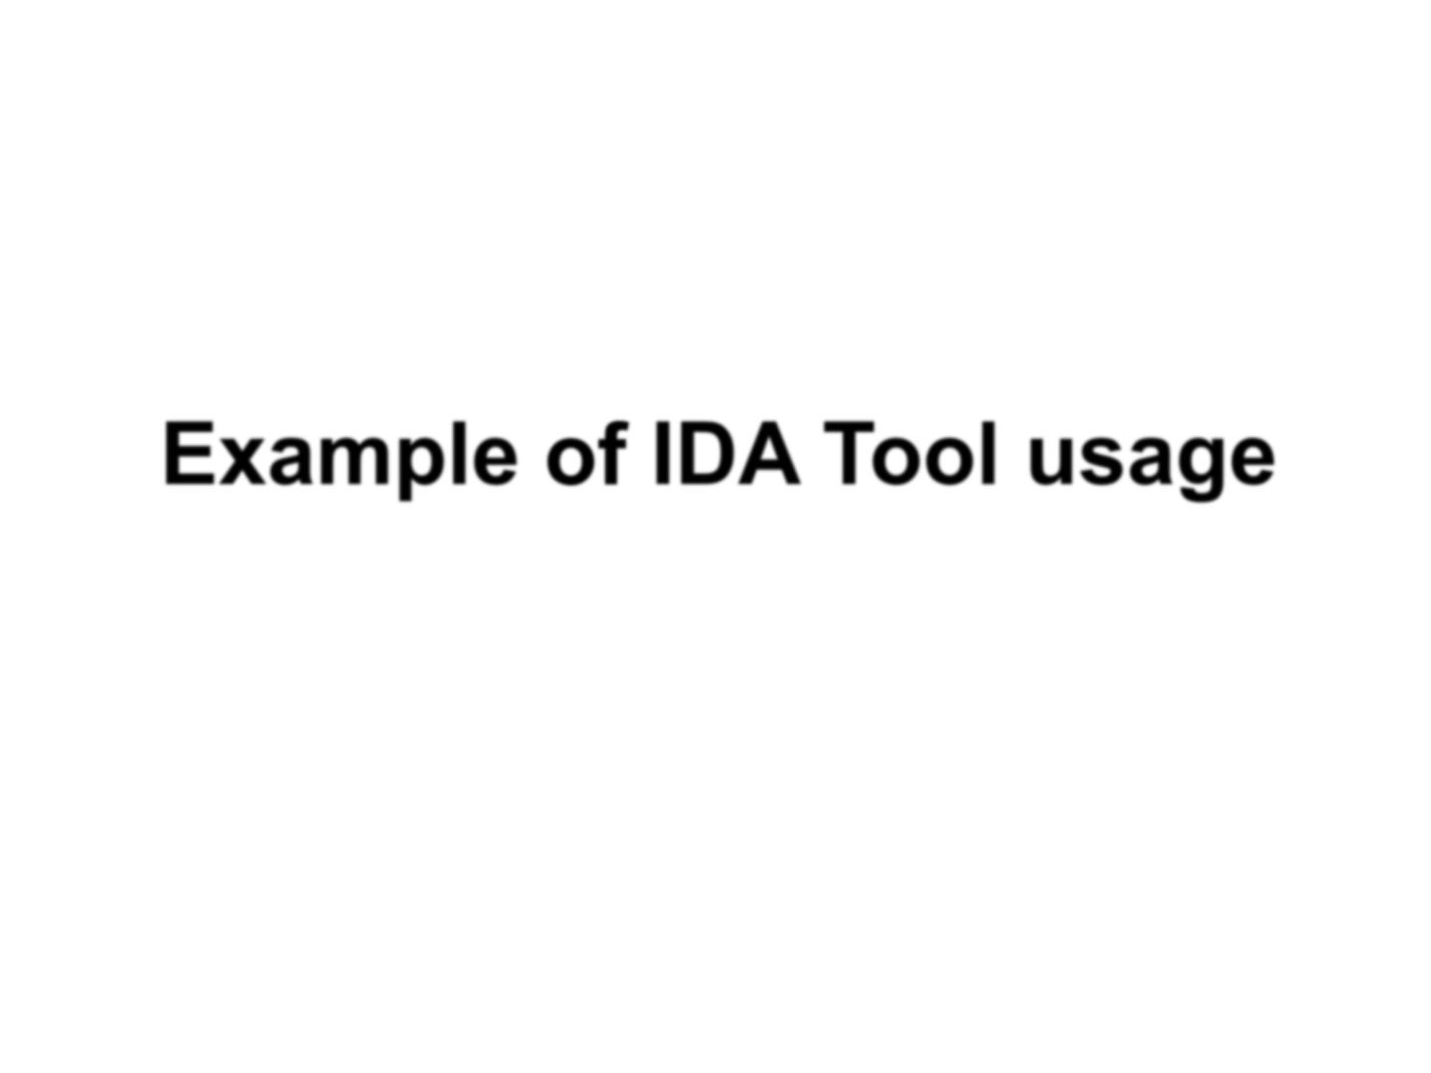

Slide 16
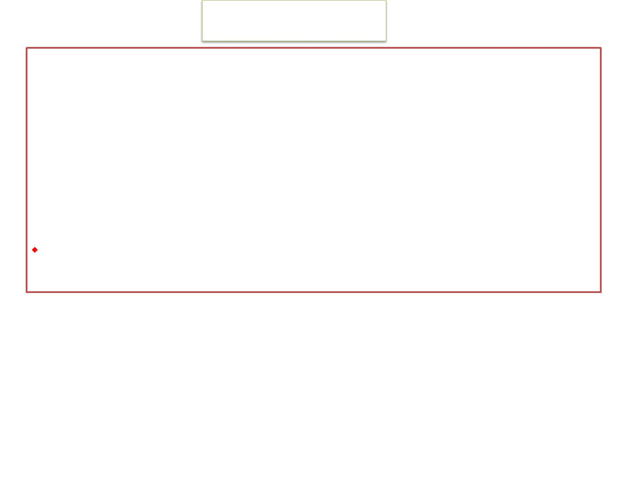
What is See5 ?
See5 – Effective data mining tools that construct classifiers.
Program for analyzing data and generating classifiers in the form of decision trees and/or rule sets.
http://www.rulequest.com

Slide 17
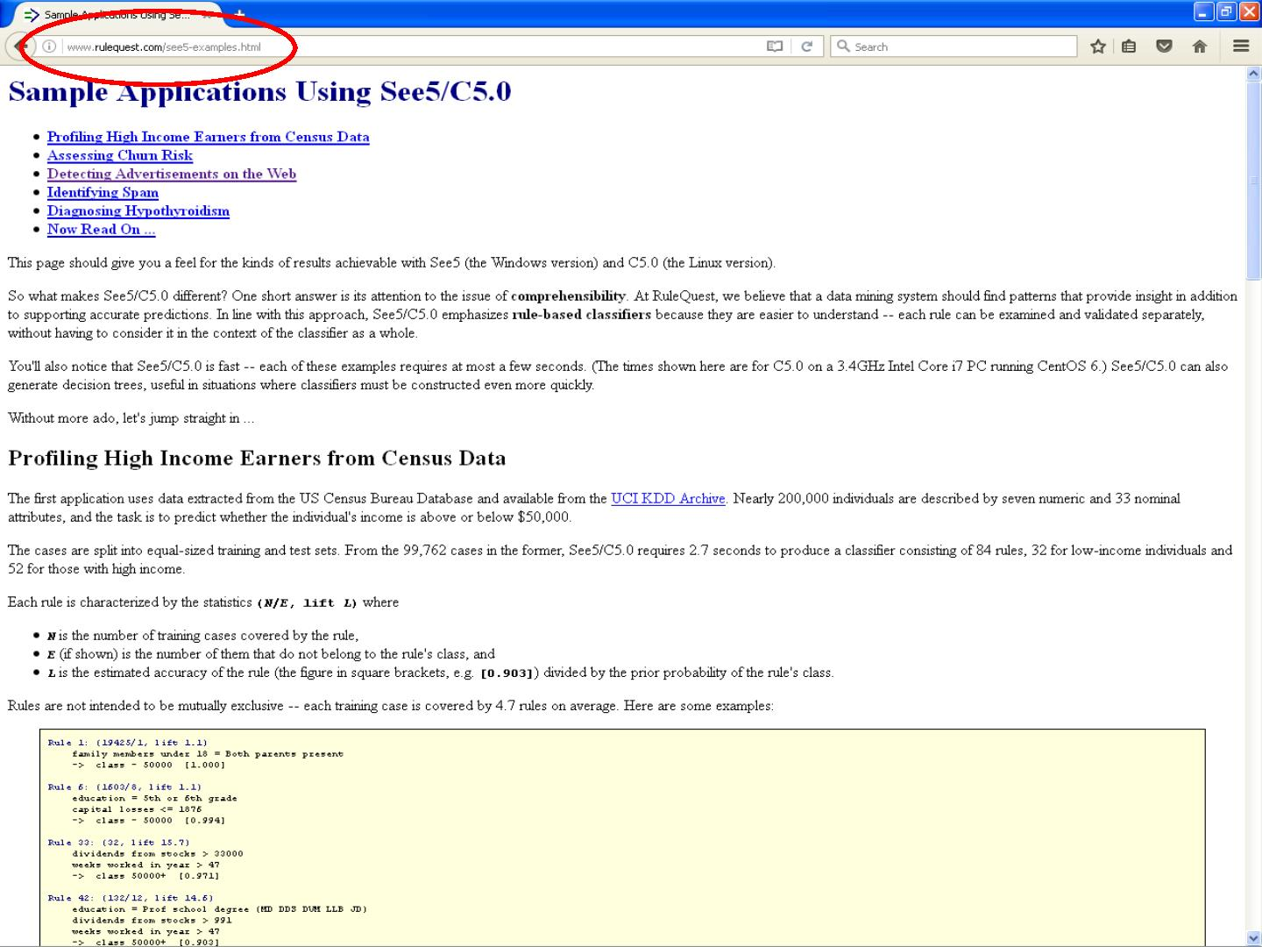

Slide 18
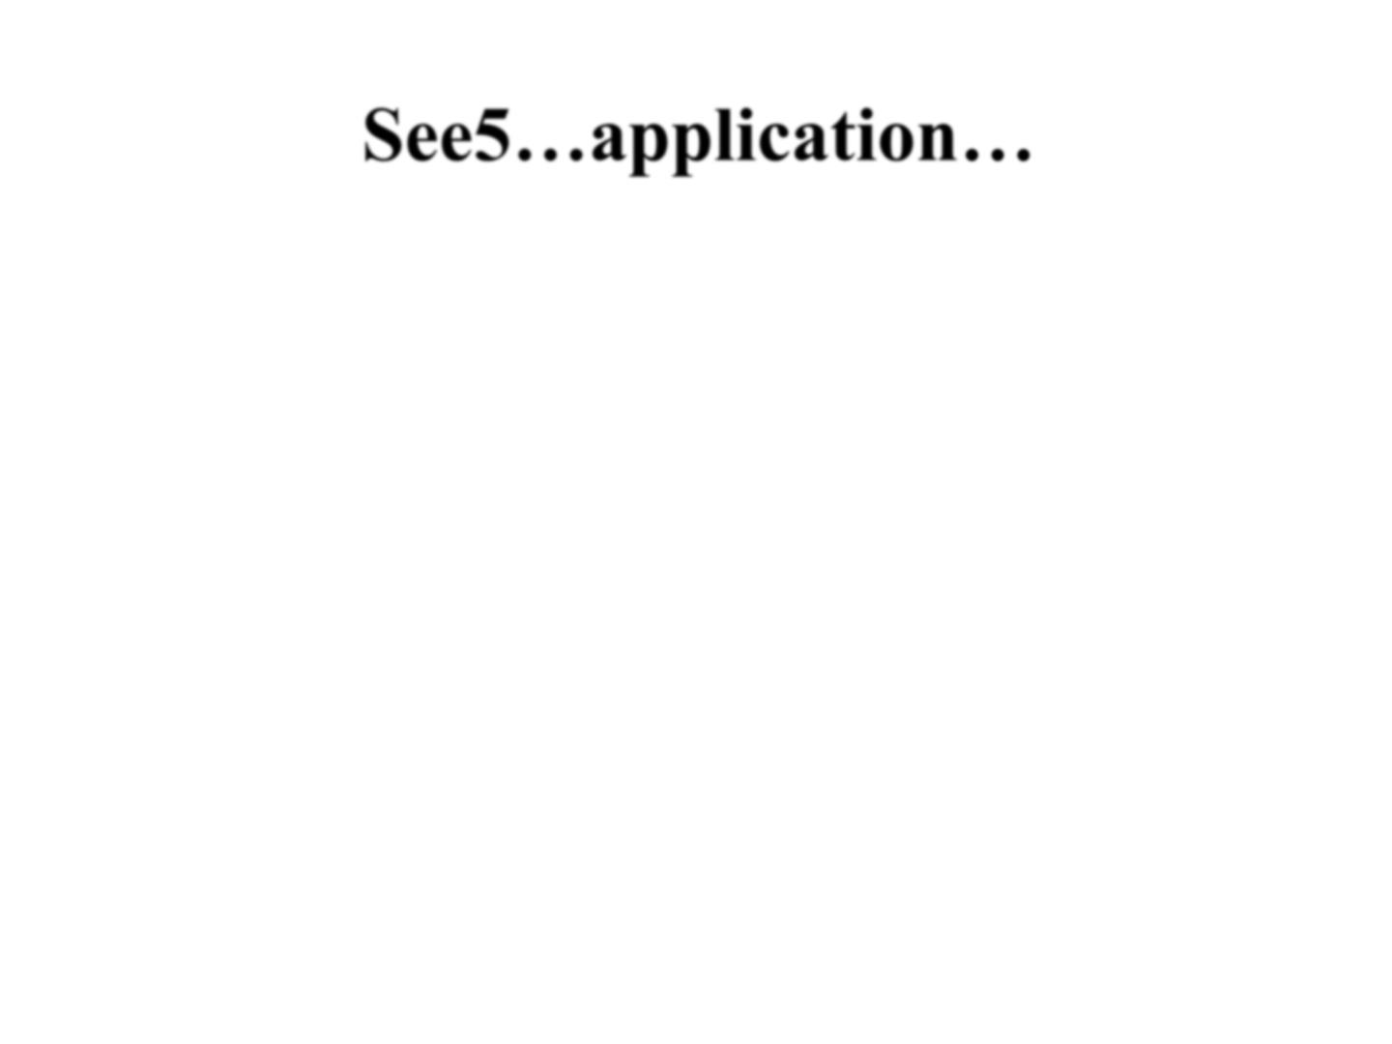
Epidemiological study (1970-1990)
Sample of examinees died from cardiovascular
diseases during the period
Question: Did they know they were ill?
1
2
– they were healthy
– they were ill (drug treatment, positive clinical and laboratory findings)

Slide 19

application.names, Habit, History…
Goal.
gender:M,F
activity:1,2,3
age: continuous
smoking: No,Yes
…
Goal:1,2
…

Slide 20
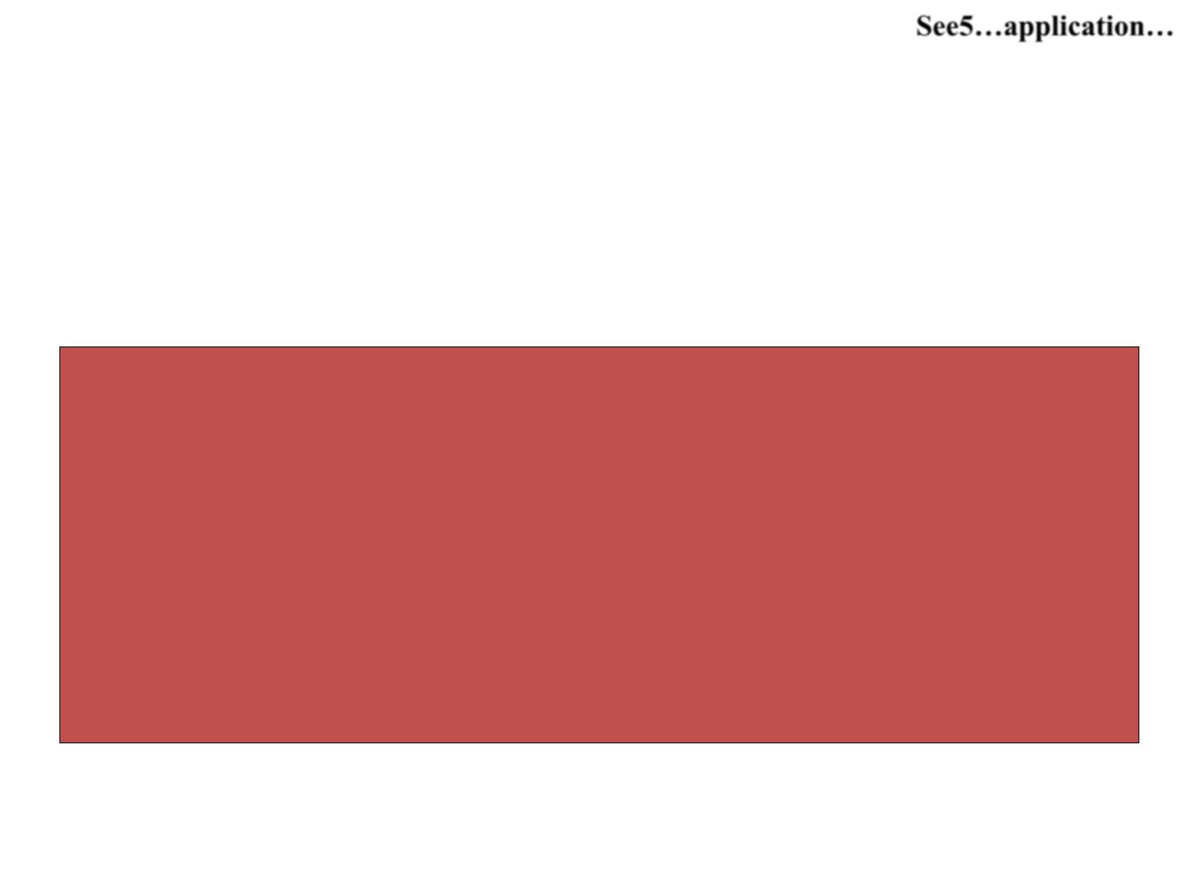
application.data – Medical History
M,1,59,Yes,0,0,0,0,119,73,103,86,247,87,15979,?,?,?,1,73,2.5
M,1,66,Yes,0,0,0,0,132,81,183,239,?,783,14403,27221,19153,23
187,1,73,2.6
M,1,61,No,0,0,0,0,130,79,148,86,209,115,21719,12324,10593,11
458,1,74,2.5
…
…

Slide 21

Framing the rules
Rule 1: (cover 26)
gender = M
SBP > 111
oil_fat > 2.9
class 1 [0.929]
->
If gender=male & systolic_blood_pressure >111 & fat_consumption THEN the
person knows he was healthy

Slide 22

Framing the rules
Rule 4: (cover 14)
smoking = Yes
SBP > 131
glucose > 93
glucose <= 118
oil_fat <= 2.9
->
class 2 [0.938]

Slide 23

Evaluation on training data
(199
cases):
(a) (b) <- classified as
----
107
17
----
3 (a): class 1
72 (b): class 2

Slide 24

Evaluation on test data
(73
cases):
(a) (b) <-classified as
----
43
3
----
1 (a): class 1
26 (b): class 2

Slide 25
Results – example (test set training data)
Validation
Sensitivity=0.98
Specificity=0.90

Slide 26
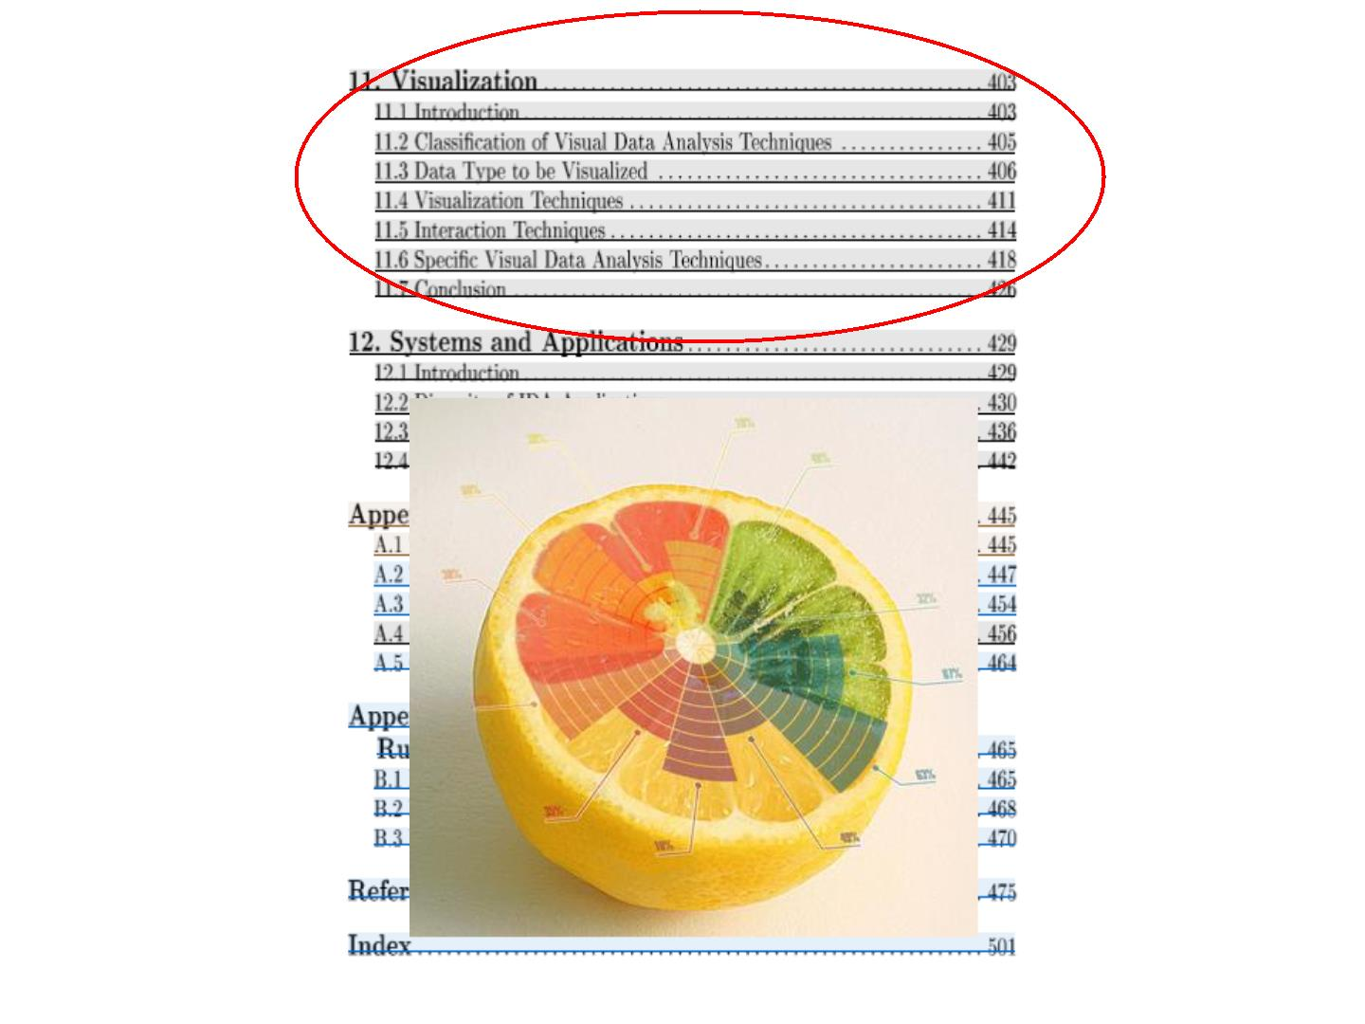
http://www.amazon.com/Intelligent-Data-Analysis-Michael-Berthold/dp/3540430601#reader_3540430601

Slide 27
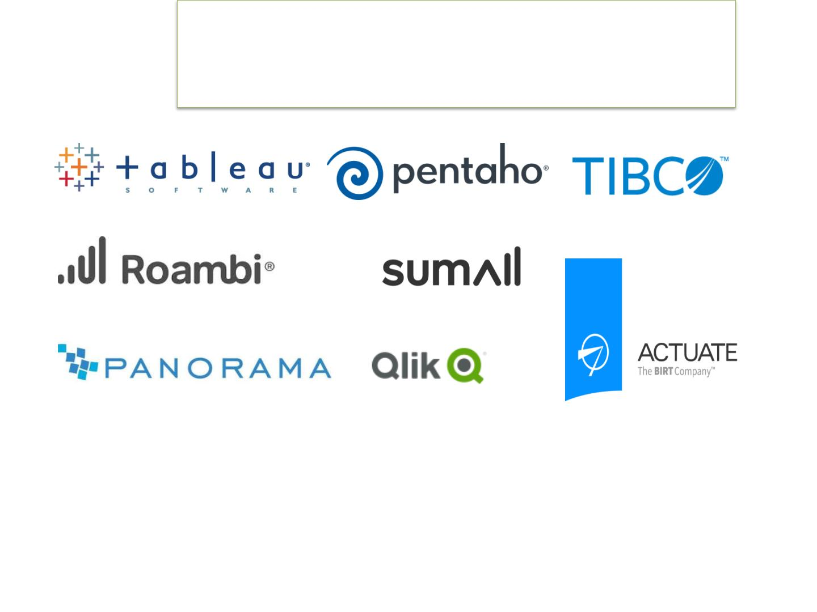
Big Data Visualization Tools to Visualize IDA Results

Slide 28
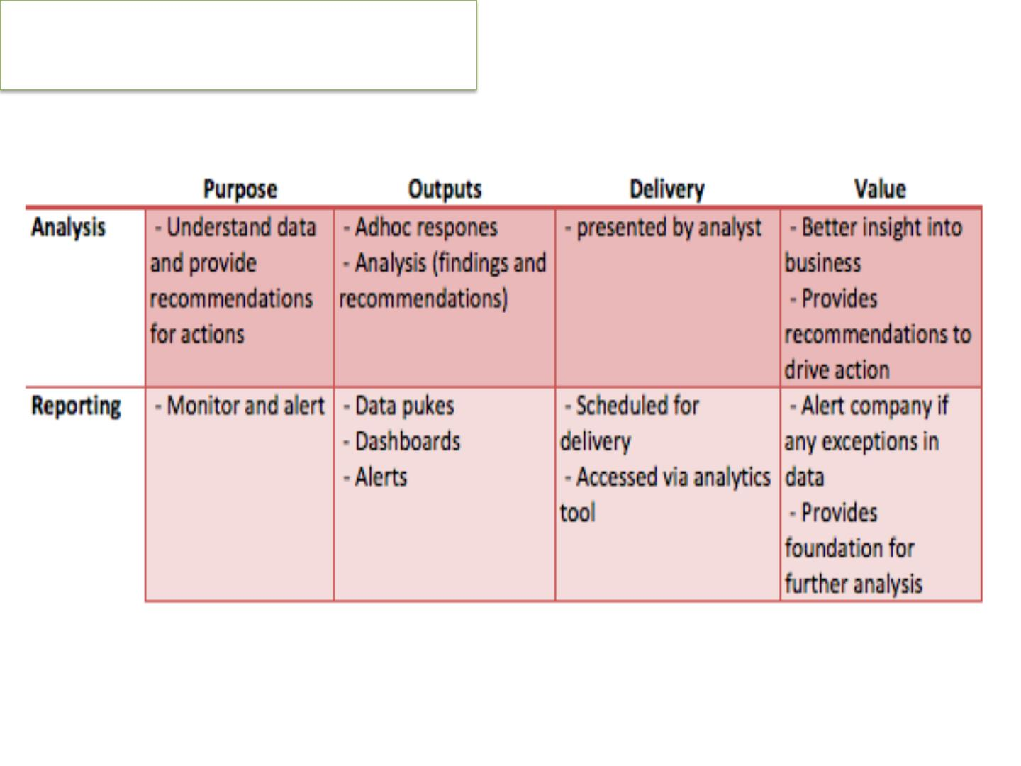
Analysis Vs Reporting

Slide 29
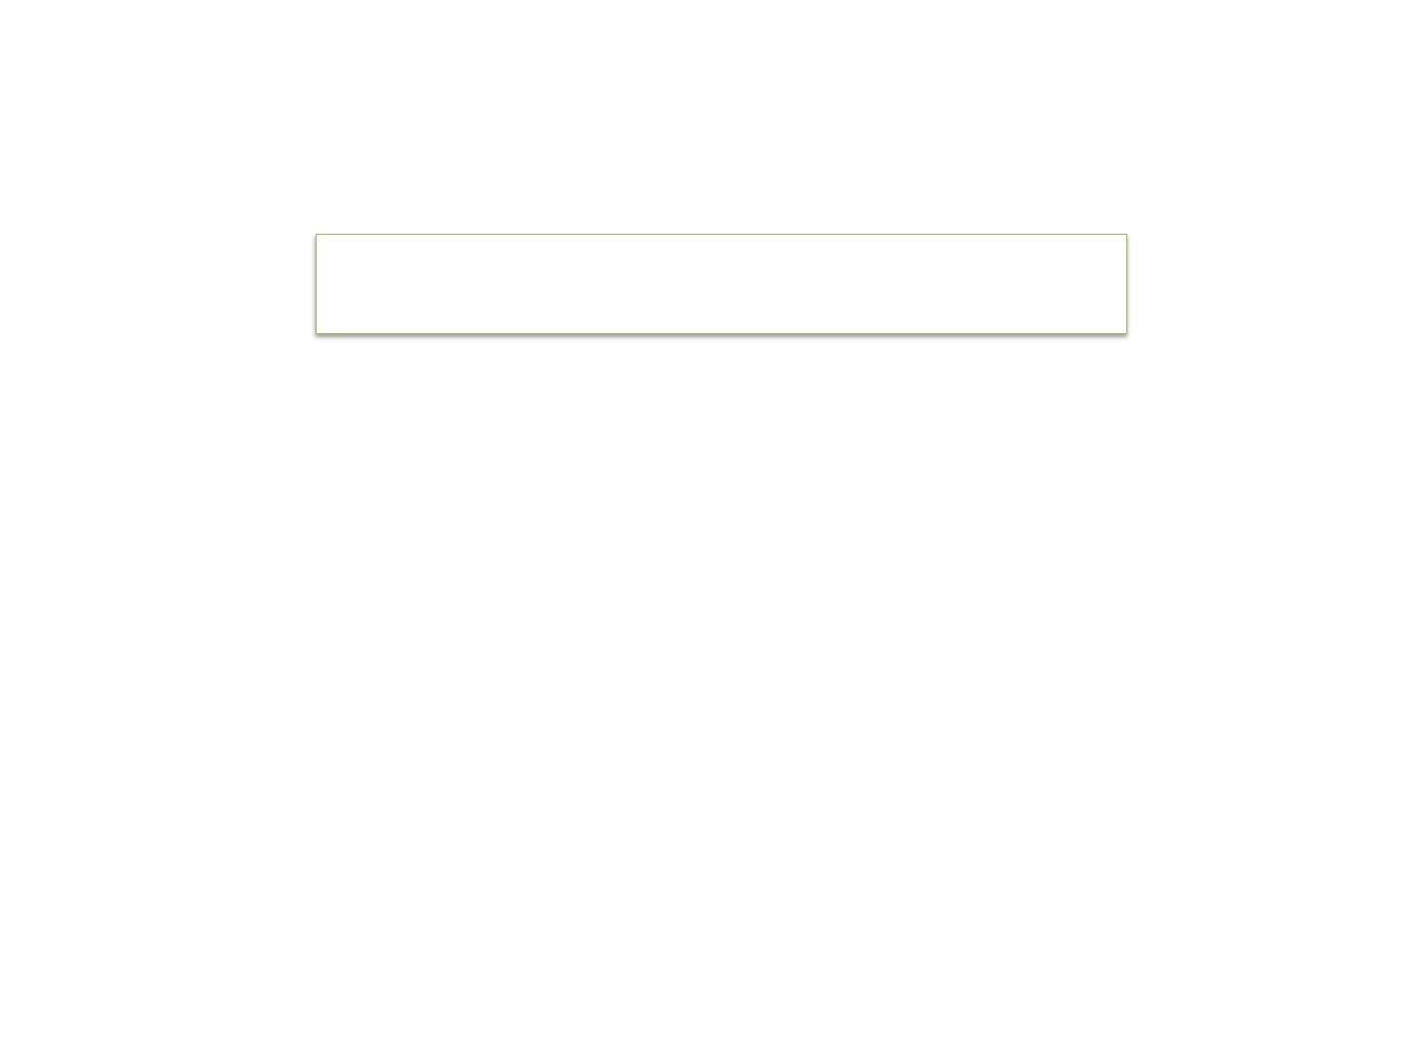
THE NATURE OF DATA
•
Information is an important factor in an
organisation’s success.

Slide 30

Data is the raw material entered into aninformation system.
If the data collected is meaningless, then the
information will have no use either. [Garbage in
•
•
=
garbage out (GIGO)]
•
Organisations need to ensure that appropriate
data is available at the time of processing.

Slide 31

•
•
Data will be appropriate if it is:
relevant – useful to the purpose of the
information system
accurate – collected from a dependable
source and entered without errors
•
•
•
timely – current, and kept up-to-date
secure – protected from deliberate and
accidental damage or loss
When data is entered into an information
•
system it is organised into different data types.

Slide 32

•
Data types include:
•
•
•
•
•
images
audio
video
text
numbers

Slide 33

•
Information will be valuable if it is:
•
•
•
•
•
relevant
accurate
timely
organised
cost-effective

